Slide 1
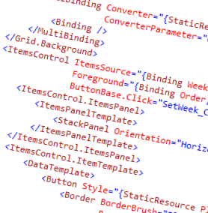
WPF and XAML
7 – Item Controls

Slide 2
Overview
What is an item control?
Item templates

Slide 3




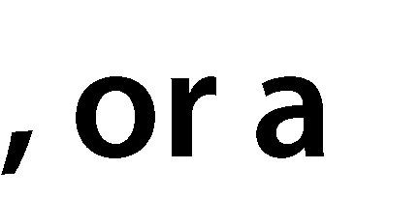
















Slide 4







ItemsControl
ItemsPanel
ItemContainer
ItemTemplate

Slide 5



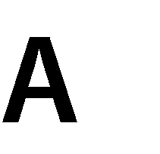



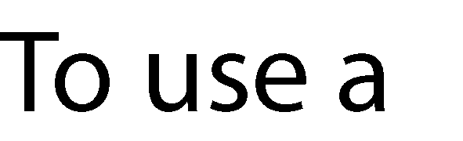







Slide 6
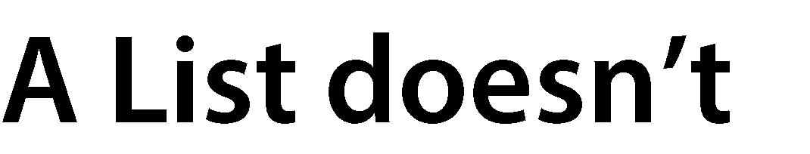


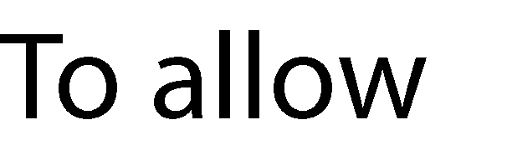









Slide 7
Summary
We went over item controls and their structure
ItemPanel
ItemContainer
ItemTemplate
Two types of templates
ItemPanelTemplate for the visual container for the items
DataTemplate for the items
Each type of object can have a different DataTemplate

Slide 8
Demo
Demo of an item control in action
ListBox demo

